Slide 1
Candidate Workshop 2020
IMPORTANT: Information in this presentation is subject to change upon passage of new legislation

Slide 2
This Power Point Presentation
is available via our website:
www.voteindianriver.com

Slide 3
2020 Elections
Presidential Preference Primary Election: March 17, 2020 Book Closing: February 18, 2020 Primary Election: August 18, 2020 Book Closing: July 20, 2020 General Election: November 3, 2020 Book Closing: October 5, 2020

Slide 4
PLEASE REVIEW YOUR HANDOUT:
2020 ELECTIONS DATES CALENDAR

Slide 5
Becoming a Candidate
Becoming a candidate is a two-part process:
Filing for office
Qualifying for office

Slide 6
Becoming a Candidate
Two forms are required to become a candidate:
DS-DE 9: Appointment of Campaign Treasurer Designation of Campaign Depository for Candidates
DS-DE 84: Statement of Candidate

Slide 7
FILING FOR OFFICE

Slide 8
Filing Officer: SOE
The SOE is the filing officer Exception: municipal candidates

Slide 9
Prior to submitting the DS-DS 9 form, IRC candidates must be:
IRC Candidate Requirements
Registered voter in IRC
Legal resident of the district they are representing when assuming office
Exception: School board and write-in candidates must be legal residents of their district at qualifying

Slide 10
DS-DE 9 Form: Appointment of Campaign Treasurer Designation of Campaign Depository for Candidates
Candidates must:
Designate a primary campaign depository
Appoint a treasurer and/or deputy treasurer(s)
File with the SOE office prior to opening a bank account (Banks require a clocked-in copy of the form)

Slide 11
Prior to Submission of DS-DE 9
DO NOT:
Accept contributions
Make expenditures
Accept signed petitions

Slide 12
PLEASE LOOK AT YOUR NEXT HANDOUT PAGE
Look
at
the
Form

Slide 13
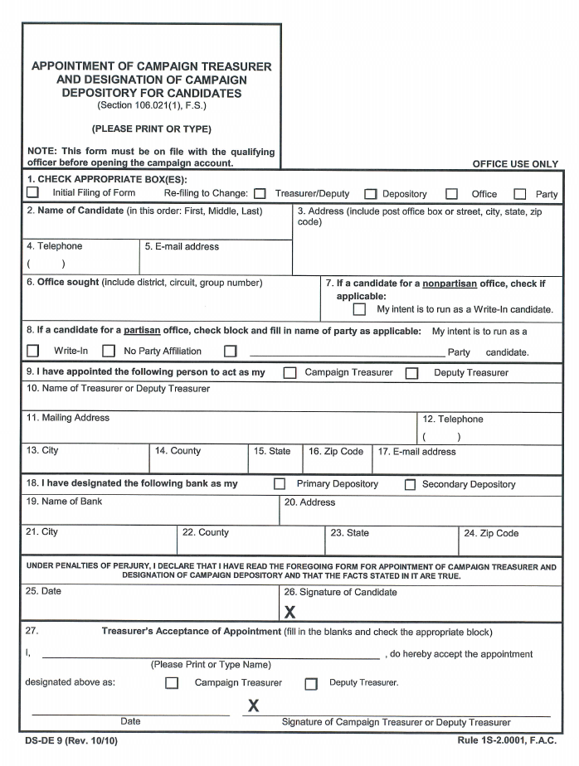
Who signs the DS-DE 9?
Candidate
Campaign Treasurer
Deputy Treasurer(s)

Slide 14
Filling Out the DS-DE 9
Form must be signed and dated by the candidate and treasurers (no more than 3 deputy treasurers)
Depository must be a Florida authorized bank, savings & loan, or credit union
May open a separate interest bearing account
Candidates: Consider being a treasurer or deputy treasurer in order to sign campaign checks

Slide 15
What if my treasurer resigns?
Resignation or removal of a treasurer and/or deputy treasurer:
Must be in writing
Not effective until filed with the SOE

Slide 16
PLEASE LOOK AT YOUR NEXT HANDOUT PAGE

Slide 17
DS-DE 84 Form
Statement of Candidate

Slide 18
DS-DE 84
Candidate has access to, read and understands the requirements of Chapter 106, F.S. (campaign finance) Must file within 10 days of filing DS-DE 9

Slide 19
QUALIFYING FOR OFFICE

Slide 20
3 Ways to Qualify as a Candidate
Pay a qualifying fee
Petition process
Write-in candidate

Slide 21
Qualifying Officer: SOE
Responsibility is ministerial in nature only
Examines the face of qualifying papers
Reviews documents to determine they are properly completed
May not determine whether contents of papers are accurate
Accepts documents if in proper order

Slide 22
April Pre-Qualifying & Qualifying Weeks
Offices that Qualify with the Florida Division of Elections:
US Senator
US Representative
State Attorney
Public Defender
Judicial candidates (except County Court Judges)
Office that Qualifies with IRC SOE:
County Court Judges
Pre-qualifying: April 6 through April 17, 2020
Qualifying: Noon, April 20 through Noon, April 24, 2020

Slide 23
June Pre-Qualifying & Qualifying Weeks
Offices that Qualify with the Florida Division of Elections:
Statewide
Multi-County candidates (Sebastian Inlet Taxing District)
Offices that Qualify with IRC SOE:
Constitutional Officers
County Commissioners
School Board
IRC Hospital District
IRC Soil & Water Management
IRC Mosquito Control
Pre-qualifying: May 26 through June 5, 2020
Qualifying: Noon, June 8 through Noon, June 12, 2020

Slide 24
Laws that may affect candidates
Resign to Run
Affects a current officer who is seeking another public office If both terms overlap, officer must resign from current office – seek DOE opinion

Slide 25
Federal Hatch Act
Restricts political activity if the employee’s entire salary is completely funded from federal dollars
Employee is precluded from being a candidate for public office in a partisan race – seek DOE opinion

Slide 26
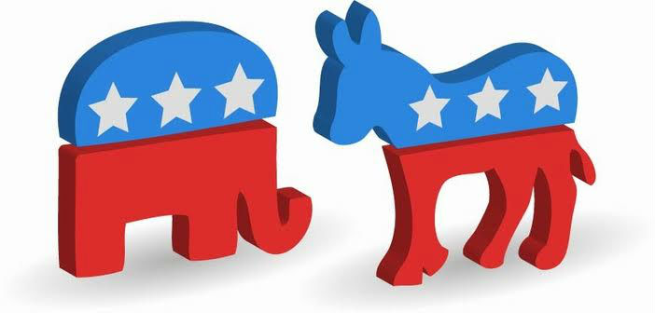
Political Party Candidates
May not have been a registered member of any other political party for: 365 days before the beginning of qualifying preceding the general election for which the person seeks to qualify May run as a no-party affiliate without changing party affiliation

Slide 27
Qualifying Fees
Fee is based on salary of office sought as of July 1, 2019
Partisan candidates: 6%
Non-partisan candidates: 4%
Exception: Fee is $25 for special district candidates

Slide 28
Qualifying Fees

Slide 29
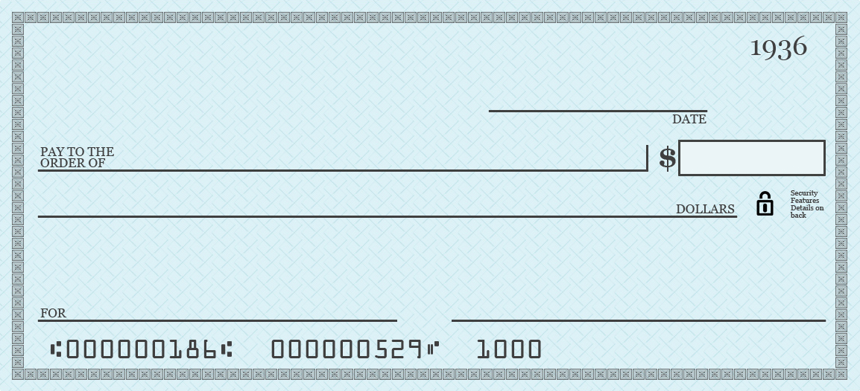
How do I pay fees?
Campaign check signed by the campaign treasurer or deputy
treasurer Candidates may sign the check
if they are a treasurer or deputy treasurer
Campaign Check
Not acceptable: Cashiers check, personal check or money order
Exception: Personal check is OK for special district candidates

Slide 30
Returned fees
Fees are returned if the candidate:
Withdraws prior to last date to qualify
Deceases prior to the last date to qualify, then the candidate’s beneficiary is entitled to the fee
Fails to qualify

Slide 31
Petition Process
No qualifying fee
1,134 valid petitions (Based on 1% of active voters in the 2018 general election)
Submit petitions to:
Local candidates: IRC SOE office Multi-county candidates: County where voter is registered
Candidate is responsible for submitting petitions to the correct county

Slide 32
Petition Verification Fees
Fee is 10 cents per petition
Fee can be paid by: Campaign check Petty cash Third party, reimbursed by campaign
Candidate is responsible for providing an accurate count
Payment is required when submitting petitions
All petitions submitted to SOE are verified

Slide 33
Petition Due Date
Deadlines for submitting petitions for verification:
April qualifying: Noon, March 23, 2020
June qualifying: Noon, May 11, 2020

Slide 34
PLEASE LOOK AT YOUR NEXT HANDOUT
Look
at
the
Form

Slide 35
Petitions:
Form DS-DE 104
Petitions must contain:
Name of candidate
Party designation
Office, including district, circuit, group or seat number, if applicable

Slide 36
Petition Requirements
Valid petitions must be signed by registered voters and include:
Name
Date of birth or voter registration number
Address, including city and county
Signature and date signed

Slide 37
DS-DE 104
Be sure to verify the
date
of
birth
for
accuracy
*
*
*
*
*
Indian River
FL

Slide 38
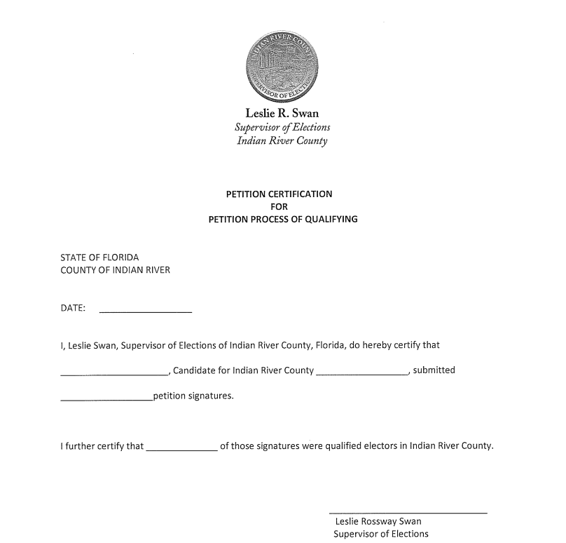
Certificate of Petition Qualifying
Issued when 1,134 valid petitions are verified

Slide 39
Oath of Undue Burden: DS-DE 19A
Candidate must file “Oath of Undue Burden” No charge for verification of signatures

Slide 40
Write-In Candidate
Not required to pay a qualifying fee or submit petitions
Must comply with finance laws
Must reside in the district at qualifying
Qualify for general election ballot only
Name will not appear on ballot

Slide 41
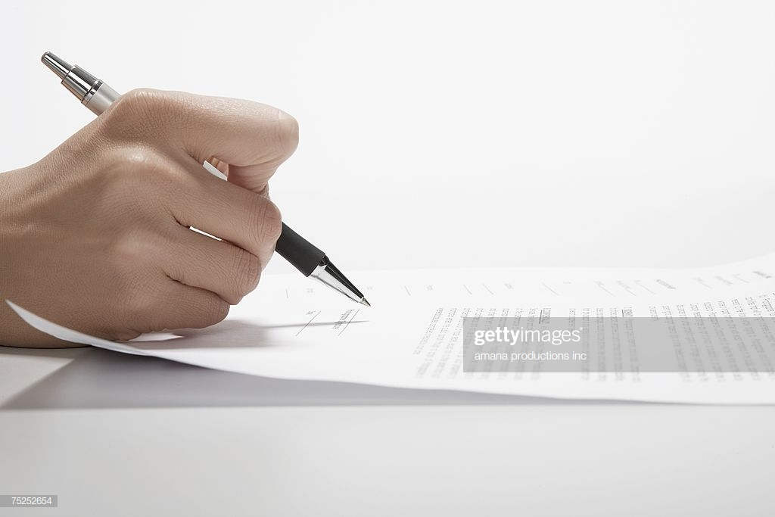
Qualifying Forms
Candidate oath (SOE will provide correct oath)
Name on oath is name printed on the ballot
Party affiliation
Properly notarized

Slide 42
Nickname on Candidate Oath
First name, shortened version of first name or nickname:
May not use descriptive information, such as esquire, doctor, reverend, etc.
Rob” instead of “Robert” is OK
Robert “Rob” Smith is OK
Robert “Buzz” Smith is OK

Slide 43
Financial Disclosure Forms: Form 1 and Form 6
SOE will provide proper form
Form 1 requires less information
Form 6 requires detailed information

Slide 44
Why Financial Disclosure Forms?
Only a snap shot of “financial situation” to disclose certain assets and sources of income
Not the same as a “financial statement”
Monitors potential conflicts of interest
Deters activity that may result in conflict of interest

Slide 45
More Qualifying Forms
Public test notification
Poll watcher information
Political signage information
Candidate handbook
Canvassing board dates

Slide 46
Qualifying ends and the fun begins
Qualifying ends June 12, 2020 at noon
Qualifying for judicial candidates ends
April 24, 2020 at noon
No corrections can be made to qualifying papers after the close of qualifying

Slide 47
CAMPAIGN FINANCE RULES

Slide 48
Common FEC Violations
Taking contributions or making expenditures before filing the DS-DE 9 Form
Giving incomplete or false information on campaign reports (others are watching)

Slide 49
Campaign Treasurer
Campaign treasurer should have some basic bookkeeping and computer skills
It is imperative that the campaign treasurer reviews every bank statement when it is received
Maintain accurate record keeping

Slide 50
Treasurer’s Duties Keep Detailed Accounts
Deposit funds within 5 business days
Bank slip must include the name of each contributor
Preserve accounts (term of office = years preserved)

Slide 51
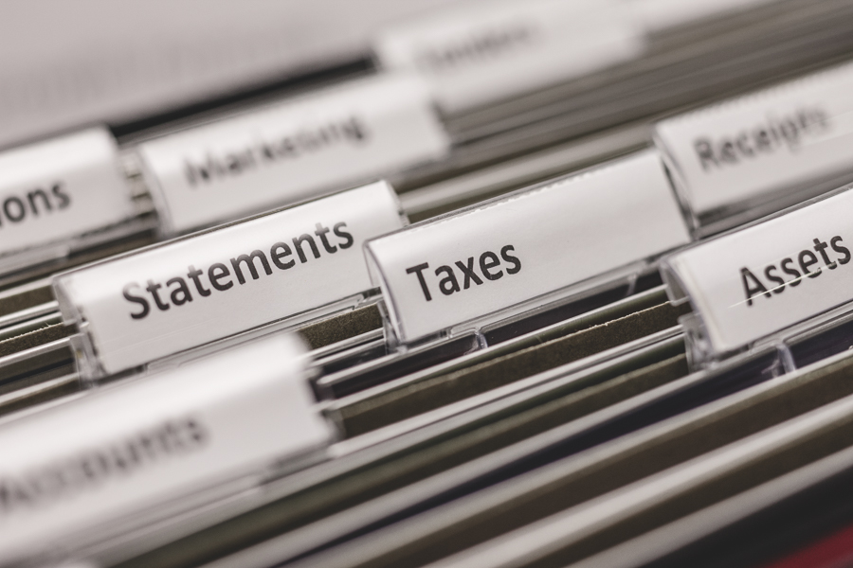
Record all Transactions
All transactions must be recorded in the campaign finance report:
Contribution
Expenditures
Bank fees
Other fees, such as Pay Pal service fees

Slide 52
Be Aware Campaign reports must be filed on time by the treasurer or deputy treasurer Fined for:
Not filing a report
Fines must be paid from candidate’s personal funds
Campaign accounts can be inspected before, during or after an election by a DOE or FEC representative.

Slide 53
When are reports due?
* Reports are due on the 10th day following the end of each calendar month after filing for office
Frequency of reports increases after the qualifying period:
Non-election year: 12 reports are due
Election year: 20 reports are due
*Statewide candidates should check with the DOE for reporting dates

Slide 54
Fines are Hefty for Late Reports
First 3 days: $50 per day After first 3 days: $500 per day Reports immediately preceding primary and general elections: $500 per day
Fines cannot exceed 25% of total receipts or expenditures, whichever is greater. Fines must be paid within 20 days of notice of payment due.

Slide 55
No contributions or expenditures in reporting period?
Required to file a “Waiver of Report”

Slide 56
Incomplete Reports
All reports are accepted on a conditional basis
We will notify you if a report is incomplete
Addendum is due within 7 days
Addendum must include updated information to complete the report

Slide 57
CAMPAIGN FINANCE: CONTRIBUTIONS

Slide 58
What is considered a contribution?
A gift, subscription, conveyance, deposit, loan, payment or distribution of money or anything of value, including contributions in-kind, made for the purpose of influencing the results of an election

Slide 59
Contribution exceptions
Exceptions include:
Services by volunteers (no compensation)
Editorial endorsements
All contributions must be reported, regardless of whether it’s 50 cents or $1,000

Slide 60
Reporting Contributions
Reporting for each contribution, must list:
Full name
Address
Specific occupation (individual), if contribution is more than $100
Principal type of business (corporation), if contribution is more than $100
Amount
Date
Be sure to report any transfer of funds or loans

Slide 61
Contribution limits for candidates
$3,000 per candidate for statewide office, retention as a Justice of the Supreme Court
$1,000 for a:
Candidate
Retention as a Judge of a District Court of Appeal County Court Judge or Circuit Judge
Legislative office
Multicounty office
Countywide office
Any election conducted on less than a countywide basis

Slide 62
When to Stop Accepting Contributions
Candidates may not accept contributions after:
The date the candidate withdraws his or her candidacy
Is defeated
Becomes unopposed
Is elected

Slide 63
Contribution Limits
Exception: Contribution limits do not apply to contributions by a candidate to his or her own campaign

Slide 64
REMEMBER!
The primary and general elections
are separate elections

Slide 65
Debit and Credit Card Contributions
A candidate may accept contributions via:
Credit card
Debit card
Money order
Categorized as a “check” for reporting purposes

Slide 66
Cash Contributions
A cash contribution may not exceed $50 per election
Note: Money orders and traveler’s checks
are not considered “cash”

Slide 67
In-kind Contributions
Anything of value made for the purpose of influencing the results of an election
Candidates may give unlimited in-kind donations to their own campaign
In-kind contributions:
Must be reported using a fair market value
Are subject to contribution limits

Slide 68
Exceptions to In-kind Contributions
Personal services provided without compensation by volunteers
Independent expenditures, as defined in Section 106.011(5)F.S.
Endorsements of 3 or more candidates by political committees or parties

Slide 69
Anonymous Contributions
Must be reported as an anonymous contribution
A letter should be submitted to the filing officer explaining the circumstances surrounding acceptance of an anonymous contribution
Candidate cannot spend the anonymous contribution, but at the end of the campaign, can donate funds to the appropriate entity under 106.141 F.S.

Slide 70
Joint Accounts
When a candidate receives a contribution in the form of a check drawn on a joint account, the person signing the check is considered the contributor

Slide 71
Fundraisers
All monies and contributions received from campaign fundraisers are campaign contributions
Subject to contribution limits

Slide 72
Unauthorized Contributions
Any contribution received on the day of the election or less than 5 days before the day of the election must be returned to the contributor and may not be used or expended by or on behalf of the candidate

Slide 73
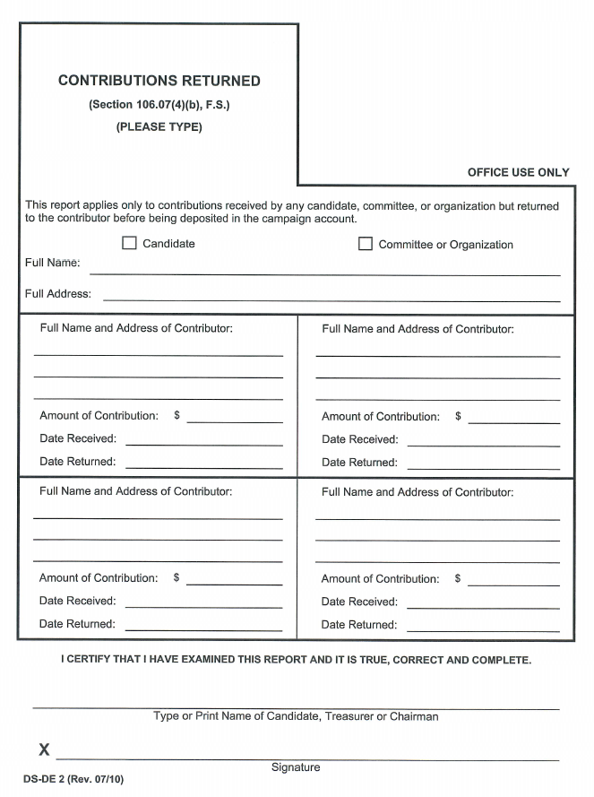
Form DS-DE 2: Returning Contributions
If the contribution has been deposited into the campaign account:
Report the contribution returned on Form DS-DE 2
Write a check from the campaign account to the contributor for the amount of the contribution

Slide 74
Returning Contributions
Report returned contributions
Use the itemized contribution report to record the contribution type as “refund”
Returned contributions are reported as a negative

Slide 75
Candidates Changing Designated Office
If a candidate changes the designated office for which they are a candidate:
Must submit a new Form DS-DE 9 and a written statement to SOE filing officer
Must notify all contributors in writing of intent to seek a different office
Must offer to return pro rata and, upon request, return the contribution within 30 days of the notification

Slide 76
Candidates Changing Designated Office
May use the contribution if the donor does not request the contribution be returned within the 30-day period
The amount of the prior contribution for the former office counts toward the contribution limit for the new office

Slide 77
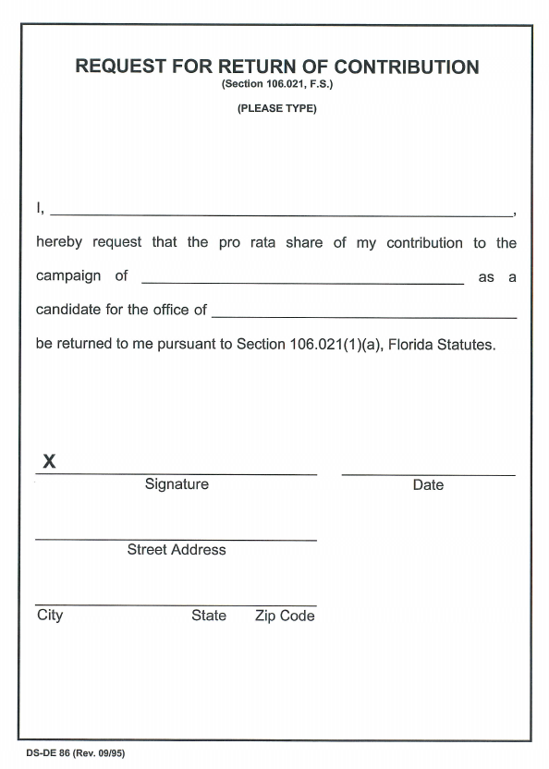
Form DS-DE 86: Request for Return of Contribution
If a contributor would like a refund, use the DS-DE 86 form to request the return of the contribution

Slide 78
Loans
Loans are considered contributions and are subject to contribution limitations Exception: Loans made by a candidate to his or her own campaign are not subject to contribution limits
A candidate making a loan to his or her campaign may be reimbursed for the loan at any time the campaign account has sufficient funds
Loans must be reported on the campaign treasurer’s report

Slide 79
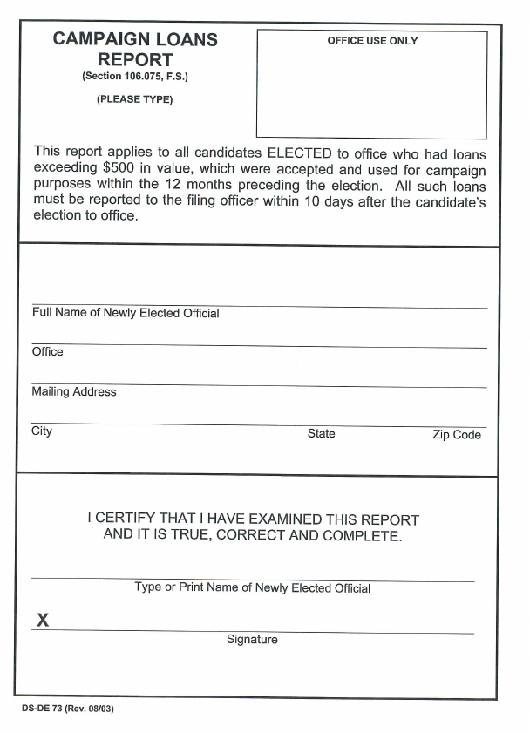
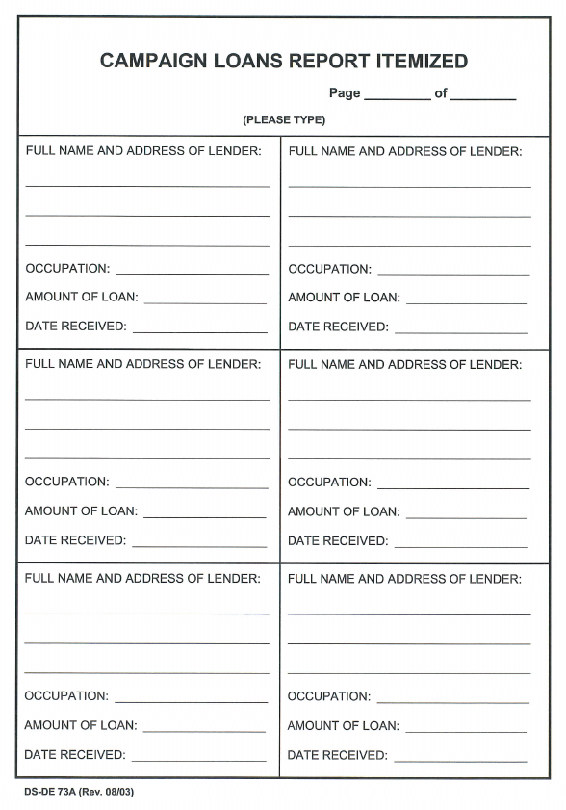
Form DS-DE 73: Campaign Loans Report
All personal loans exceeding $500 in value, made in the 12 months preceding a candidate’s election to office, must file the DS-DE 73 form Any person who makes a contribution to pay all or part of a loan incurred in the 12 months preceding the election, to be used for the campaign, may not contribute more than the amount allowed by law

Slide 80
CAMPAIGN FINANCE: EXPENDITURES

Slide 81
Campaign Finance: Expenditures
An expenditure is a purchase, payment, distribution, loan, advance or transfer of funds for the purpose of influencing the results of an election

Slide 82
Campaign Expenditures
A candidate must:
Pay all campaign expenditures with a campaign check (except petty cash)
Pay all expenses upon final delivery and acceptance of goods and services
Pay for public utilities when bill is received
(utility companies must charge a deposit to meet all anticipated charges during a billing period)

Slide 83
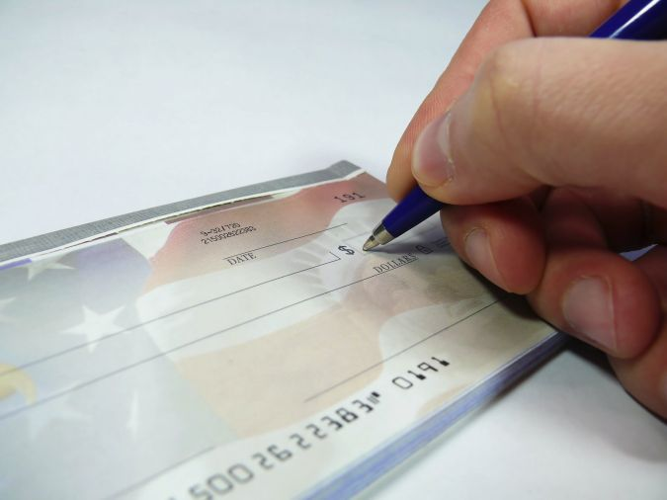
Campaign Account
Campaign accounts must contain:
Name of the candidate or committee within it
Name of bank
Account number

Slide 84
Campaign Checks
Checks must contain as a minimum the following information:
Exact amount of expenditure
Signature of campaign treasurer/deputy treasurer, who is responsible for accuracy of all checks
Exact purpose of expenditure
Name of the payee

Slide 85
Name of the campaign account of the candidate or political committee
April 6, 2018
Pay To The Order of
A-1 Sign Company______________________________$ 150.00
One Hundred and Fifty and 00/100__________________ Dollars
Hometown Bank
Hometown, FL 01234
FOR Sign Materials Signature of Campaign Treasurer
Information may be typed or hand printed on starter checks provided by the bank until printed checks arrive

Slide 86
Debit cards
Debit cards may be used for campaign expenditures:
Must be from the same bank as the designated primary depository
Must be issued in the name of the treasurer, deputy treasurer or authorized user
Must contain the name of the candidate
No more than three debit cards shall be issued
Cannot receive cash back

Slide 87
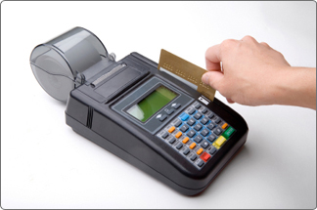
Debit Card Receipts
All debit card receipts must contain:
Last four digits of the debit card number
Exact amount of the expenditure
Name of payees
Signature of authorized user (treasurer, etc.)
Exact purpose of expenditure
If not included on the receipt, information may be handwritten

Slide 88
Credit Cards
Candidates for statewide office, such as governor, cabinet and supreme court justice, may obtain and use credit cards for travel related campaign expenditures

Slide 89
Expenditures
IMPORTANT: No candidate, campaign manager, treasurer or deputy treasurer shall authorize any expenses, unless:
There are sufficient funds on deposit in the primary depository account to pay the full amount of the expenditure
Sufficient funds to honor all other checks drawn on the account
All expenses previously authorized but not yet paid

Slide 90
Reporting Expenditures
Each report must contain:
Full name
Address
Amount
Date
Purpose of expenditure
Total amount withdrawn from total spent from petty cash
Total sum of expenditures during the reporting period

Slide 91
Reimbursing Expenses
Reimbursement for authorized expenses made in connection with the campaign
For example, Candidate Smith paid for printing of campaign signs with his own money

Slide 92
Reimbursing Expenses
This type of reimbursement will require two entries
Entry #1: ITEMIZED EXPENDITURES
A check to reimburse Mr. Smith for the cost for printing campaign signs would be recorded as a reimbursement

Slide 93
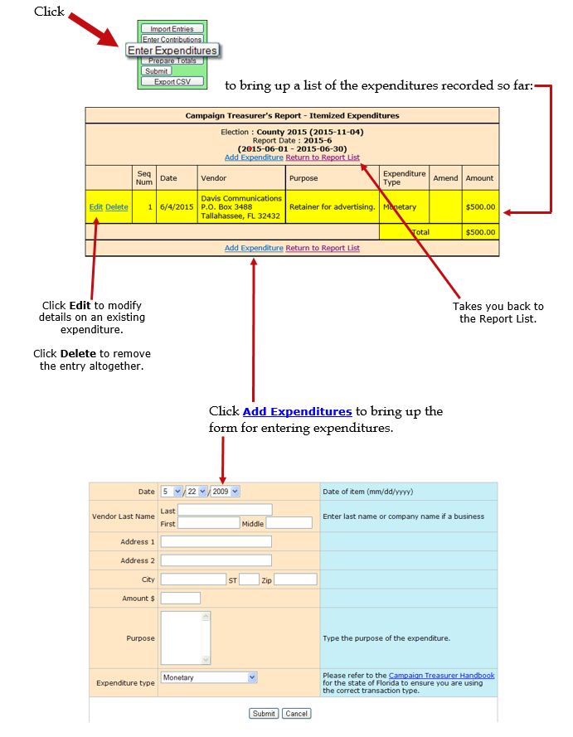
To record an expenditure
Swan, Leslie
Campaign Signs
RM
$3,101.00
$3,101.00

Slide 94
Reimbursing Expenses
Entry #2: Distributions
This entry would designate information regarding the entity who was paid for the campaign signs

Slide 96
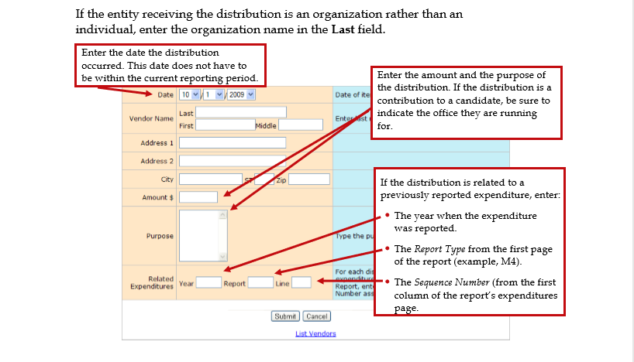

Slide 97
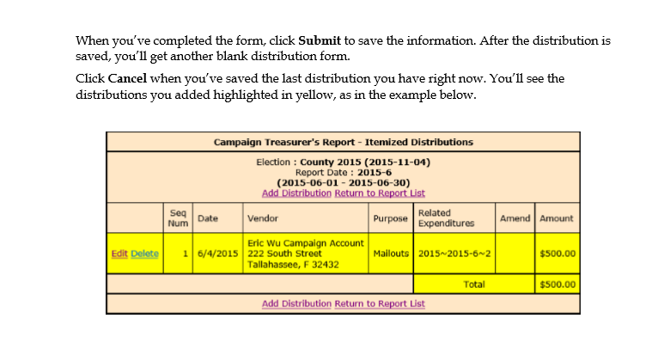
All Service Graphics, Inc.
1020 West Eau Gallie Blvd.
Melbourne, FL 32935
Campaign Signs
$3,101.00
$3,101.00

Slide 98
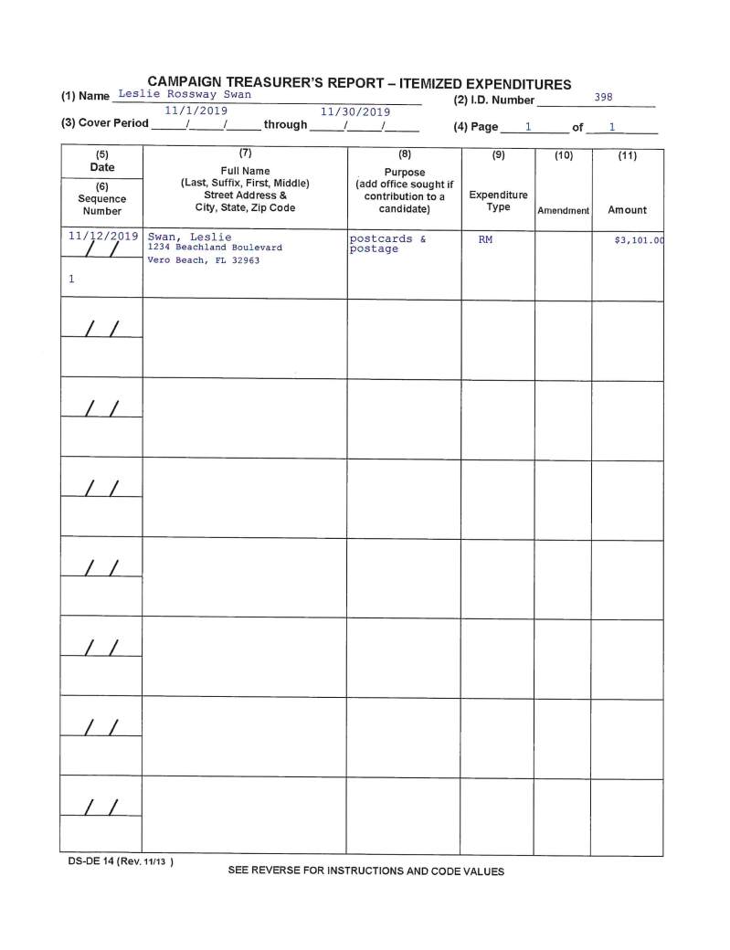
Entering Expenditures For Reimbursement

Slide 99
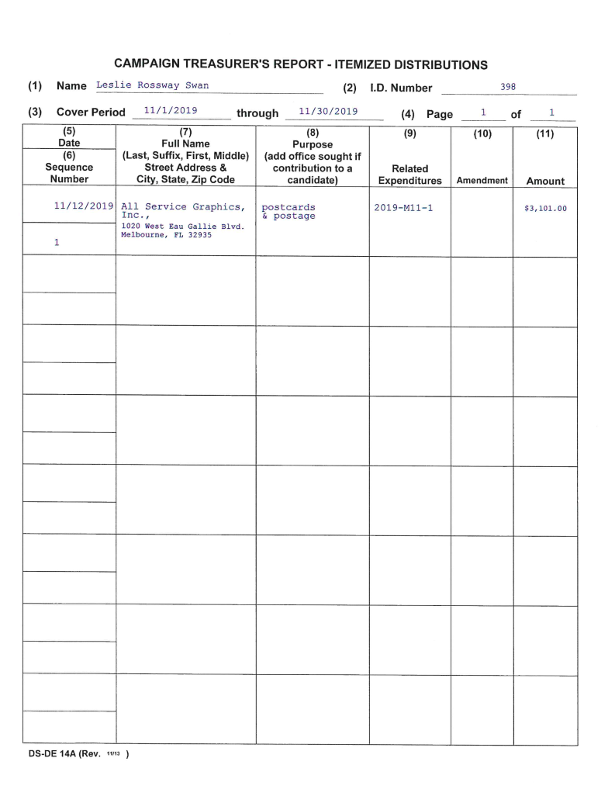
Entering Distribution Corresponds to Reimbursement

Slide 100
Note
A distribution transaction does not add to your report totals. The distribution line item only explains the reason for the purchase

Slide 101
Reimbursement
A candidate or other individual may be reimbursed for expenses by a check drawn on the campaign account Reimbursement must be reported

Slide 102
Fundraisers
All expenses incurred from a campaign fundraiser are campaign expenditures

Slide 103
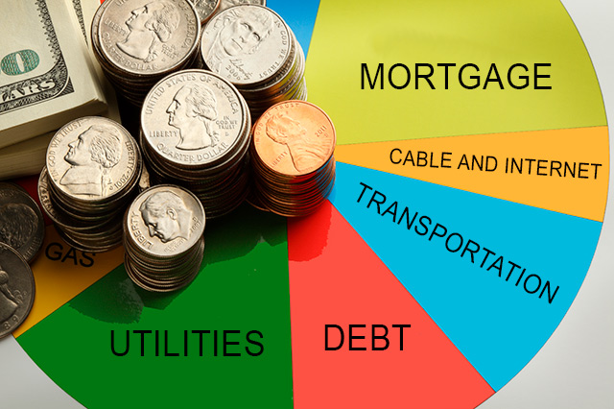
Living Expenses
A candidate and/or spouse of a candidate may not use campaign funds to defray normal living expenses Only expenses incurred during the campaign for transportation, meals, and lodging may be reimbursed

Slide 104
Petty Cash Funds
Campaign treasurer may provide a petty cash fund
Campaign treasurer must write a check drawn on the primary campaign account for petty cash
Petty cash may only be used for office supplies, transportation expenses, and other necessities

Slide 105
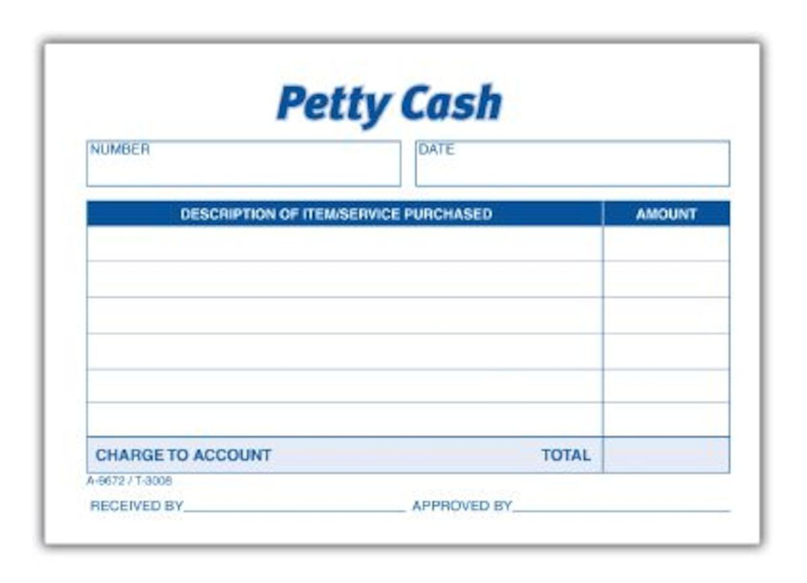
Petty Cash Limits
A candidate must:
Spend petty cash only in amounts less than $100
Report total amount withdrawn or spent from petty cash per report period
Keep complete records of petty cash

Slide 106
Reporting Petty Cash Expenditures
Each expenditure does not have to be reported individually
Do not mix cash contributions with petty cash
Do not use petty cash for the purchase of time, space or services from any communications media

Slide 107
Petty Cash Maximums
From the date a candidate appoints his or her campaign treasurer, until the last day of qualifying for the office:
Petty cash maximum is $500 per calendar quarter
After qualifying is over and until the election:
Petty cash maximum is $100 per week for local candidates

Slide 108
Using Campaign Funds After Election
Campaign funds may be used after election night as long as the candidate obligates the funds before election night Otherwise, the candidate would have to use his or her own funds (for example, to hold a victory party)

Slide 109
Disposing Surplus Funds
Any candidate required to dispose of funds may, before such disposition, be reimbursed by the campaign, in full or in part, for any reported:
Contributions to the campaign by the candidate
Loans to the campaign by the candidate

Slide 110
Expending Surplus Funds
Once a candidate withdraws, becomes unopposed, is eliminated or elected to office, he or she may only expend funds from the campaign account by:
Purchasing “thank you” advertising for up to 75 days after candidate withdraws, becomes unopposed, eliminated or elected to office
Paying for items that were obligated before candidate withdrew, became unopposed, was eliminated, or elected to office

Slide 111
Expending Surplus Funds
Expend surplus funds by:
Paying for expenditures necessary to close down the campaign office and prepare final campaign reports
Giving funds to the county executive committee of a political party per 106.141F.S.

Slide 112
Surplus Funds and Termination Reports
Within 90 days of withdrawing as a candidate, becoming unopposed, elected or eliminated:
A termination report must be filed
Funds must be dispersed
Account must be closed

Slide 113
Dispersing Funds
Funds may be dispersed of by any of the following means, or a combination of:
Return pro rata to each contributor the funds that have not been spent or obligated
Donate the excess funds to a 501(c)(3) charity or organization
Give the funds to the candidate’s political party

Slide 114
Dispersing Funds
Give the Funds to:
Candidate for state office, to the state to be deposited in the General Revenue Fund
Candidate for office of a political subdivision, to such political subdivision, to be deposited in their general fund
See 106.141F.S.

Slide 115
Dispersing Funds
Transfer some funds to an office account and file quarterly reports until all funds are depleted Note: A candidate elected to state office may retain up to $20,000 in a campaign account for use in next campaign for the same office

Slide 116
Refund Checks
If a refund check is received after all surplus funds have been disposed of:
The check may be endorsed by the candidate and the refund disposed of pursuant to Section 106.141 F.S.
An amended termination report must be filed with the filing officer

Slide 117
Affidavit of Undue Burden Reimbursement
If a candidate filed an Affidavit of Undue Burden (unable to pay the fee for petition verification), he or she must reimburse any waived petition verification fees to the state or local government

Slide 118
CANDIDATE FINANCE REPORTING

Slide 119
Filing Campaign Reports
Start by keeping your bank statements current and balanced
Keep current with your campaign contributions and expenditures in the campaign reporting module
Do not forget to list on
your campaign finance reports any bank charges
or other expenses that are automatically
deducted from your account

Slide 120
Filing Candidate Reports Online
Reports must be submitted via SOE website
When data entry is complete, report is submitted using electronic signature(s)
Reports will be released on VoteIndianRiver.com when accepted by SOE

Slide 121
Filing Candidate Reports Online
When you file for office, you will be provided with:
Candidate ID number
Candidate password
Candidate PIN (for electronic signature)
Treasurer PIN (for electronic signature)
“How to File Financial Reports” Manual

Slide 122
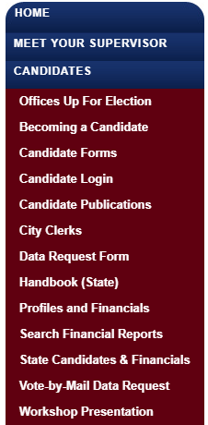
Filing Reports
Go to SOE website: voteindianriver.com
Click on: Candidate Login

Slide 123
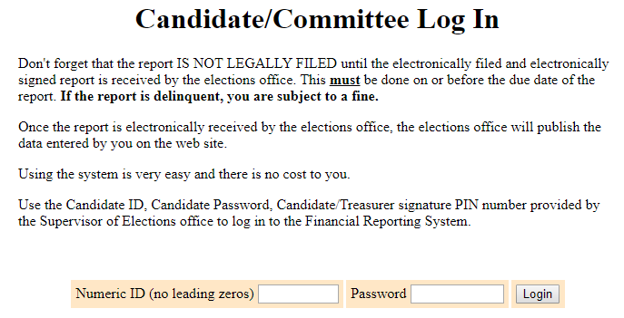

Slide 124
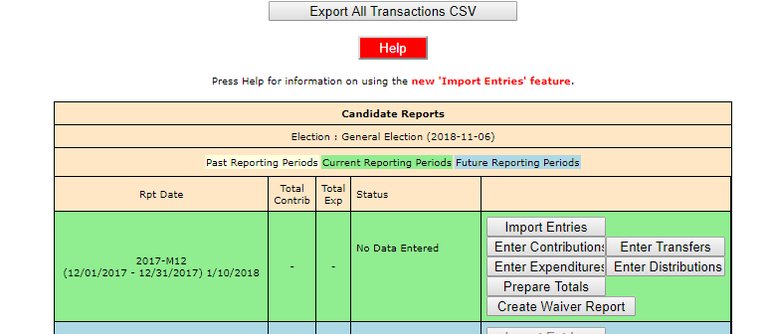
Entering contributions and expenditures
Choose the reporting period
Enter contributions, expenditures, distributions, etc.
NOTE: The RED Help button is a step-by-step tutorial for “How to File Finance Reports Online”

Slide 125
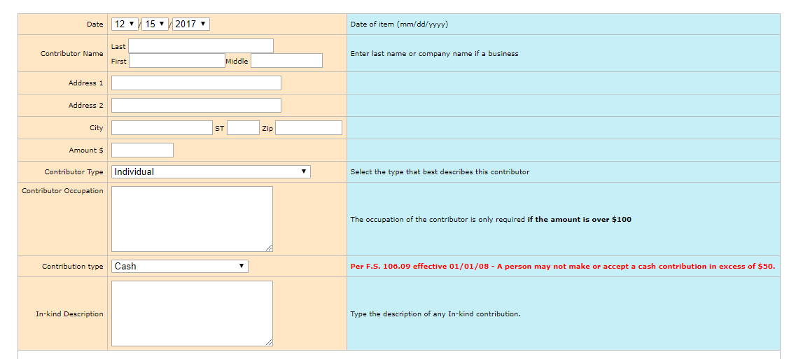
Entering Contributions

Slide 126
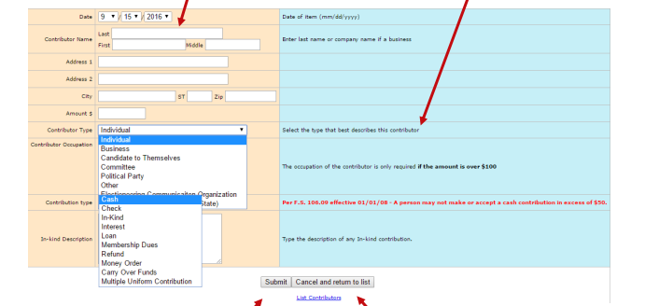
Submitting Entries
Click “submit” after each entry
When finished with all entries for your session, select “cancel and return to list”

Slide 127
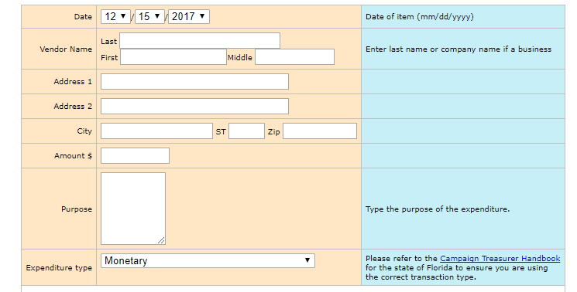
Entering Expenditures

Slide 128
Finalizing the report
When done entering all information for the reporting period, select “prepare totals”

Slide 129
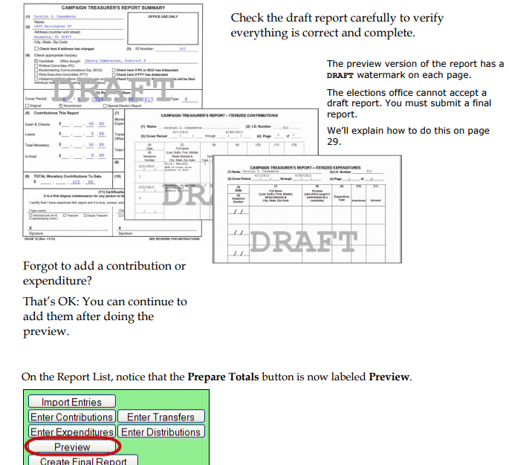
Previewing the Report
Preview a report -
Draft

Slide 131
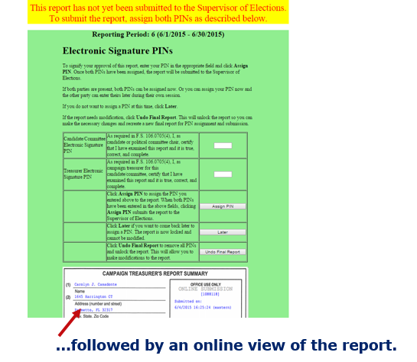
Electronic Signature
Use your PIN, which is an electronic signature

Slide 132
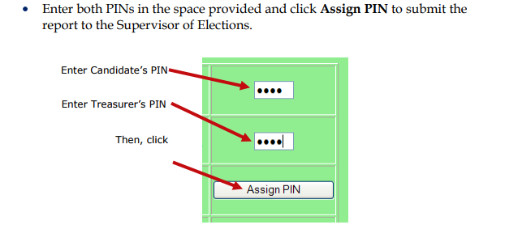
Electronic signature
You must enter:
Candidate’s PIN
Treasurer’s PIN
Always select “Assign PIN”

Slide 133
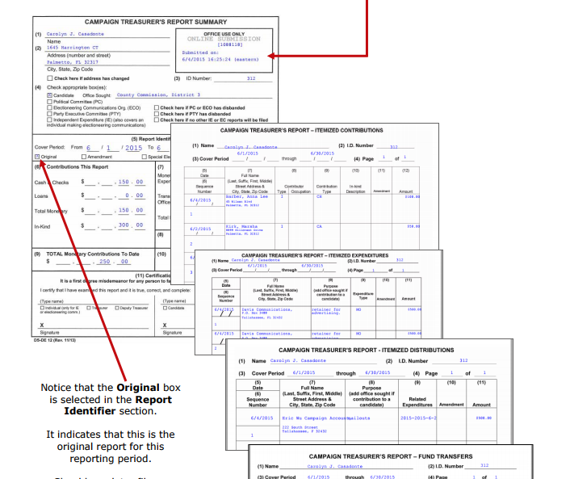
Creating a Final Report
Final report appears
and “draft” is gone
Notice the submitted date and time

Slide 134
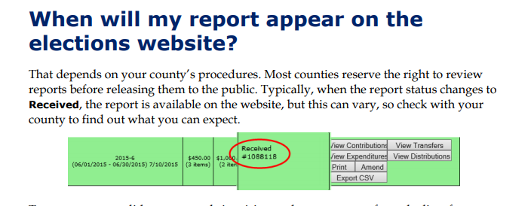
Report Received
Notice that report has been received on the reports page
Upon SOE approval, report will be released on SOE website

Slide 135
Modifying a report
You can always change a report by filing an amended report for a current or a past reporting period

Slide 136
POLITICAL ADVERTISING

Slide 137
Political Advertising
A political advertisement is a paid expression in a communications media prescribed in Section 106.011(15) F.S., which expressly advocates the election or defeat of a candidate or the approval or rejection of an issue Political advertisements include radio, TV, newspaper, campaign literature, mail or messages other than the spoken word in direct conversation

Slide 138
Advertising Disclaimers
Advertising disclaimers are required for political ads that are paid for by a candidate and published or circulated Disclaimers must be verbatim per Section 106.143 F.S.
Reminder: All candidates receive a copy of the Florida Election Code when filing

Slide 139
Political Ads Paid for by Candidate
If published, displayed or circulated before or on election day, political advertisements must state:
“Political advertisement paid for and approved by name of candidate, party affiliation, for office sought,” or
“Paid for by name of candidate, party affiliation, for office sought”
Section 106.143(1)(a)(1), F.S

Slide 140
Disclaimer Exceptions
There are many exceptions to disclaimer requirements in advertising under Section 106.143 (1-10) F.S., such as items designed to be worn by a person, which do not require a disclaimer

Slide 141
Refer to 106.143 (1-10) F.S. for all disclaimer requirements
Disclaimer Exceptions
Any candidate running for an office with a district, group or seat number does not have to indicate the district, group or seat number in a political advertisement

Slide 142
Definitions
Incumbent: Candidate who is currently holding office Non Incumbent: Candidate who is running for an office and does not currently hold the position Partisan candidate: Candidate who can campaign and qualify for office with a political party affiliation Non Partisan candidate: Candidate who is prohibited from campaigning and qualifying for office with a political party affiliation

Slide 143
Running for a Partisan Office?
Candidate shall state the name of the political party of which candidate is seeking in the advertisement
Section 106.143(3) F.S.

Slide 144
Incumbent Candidates
The word “re-elect” in an advertisement may only be used for an incumbent candidate: Example: Re-elect Jane Doe for …
Section 106.143(6)F.S.

Slide 145
Non-incumbent Candidates
Non-incumbent candidates must use the word “for”
in advertisements so that incumbency is not implied
Example: Elect Jane Doe for …
Section 106.143(6)F.S.

Slide 146
No-Party Candidates
Candidates for a partisan office running with no party affiliation must state that the candidate has no party affiliation
Example: Jane Doe, no party affiliation, for… Section 106.143(3) F.S

Slide 147
Write-in Candidates
Write-in candidates must state “write-in candidate” in advertisements Example: Jane Doe, write-in candidate for…
Section 106.143(1) F.S

Slide 148
Fundraisers
Any tickets or advertising for campaign fundraisers must comply with the disclaimer requirements in Section 106.143 F.S.

Slide 149
Political Advertisement Endorsements
An ad placed by an organization in support of a candidate must be approved by the candidate
Since the organization paid for the ad, it is considered an in-kind donation to the candidate, and must:
State who supported and paid for the ad
Include “in-kind” in the ad
Be approved by the candidate, who must provide a written statement of authorization
Section 106.143(5) F.S.

Slide 150
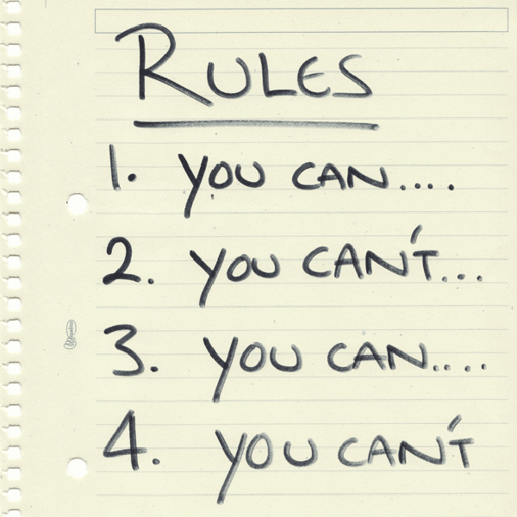
Political Advertisement Endorsements Section 106.143(4)(a) F.S.
The endorsement does not apply to an editorial endorsement advocating the candidacy of its nominees by any:
Newspaper
Radio
TV station
Other recognized news medium publication by a party committee

Slide 151
Independent Expenditure
An expenditure made for the purpose of expressly advocating the election or defeat of a candidate and cannot be coordinated with any candidate Must state: “Paid political advertisement paid for by name of organization This advertisement was not approved by any candidate” Must provide a written statement that no candidate has approved the advertisement to the advertising medium Section 106.143(5)(b) F.S.

Slide 152
Advertising in Another Language
May provide any disclaimers required in the language used in the advertisement
Section 106.143(9) F.S.

Slide 153
Closed Captioning
Each candidate, political party and political committee must use closed captioning and descriptive narrative, or must file a written statement with the qualifying SOE officer with reason for not doing so
Section 106.165, F.S.

Slide 154
Telephone Solicitation
Caller must identify the persons or organization sponsoring the call by stating “paid for by” or “paid for on behalf of”
No telephone call shall state or imply that the caller represents any organization unless given the approval in writing
Section 106.147, F.S.

Slide 155
PLEASE LOOK AT YOUR NEXT HANDOUT PAGE
Look
at
the
Form

Slide 156
Q & A
Q. A candidate running for a partisan office is placing and paying for an advertisement in a local newspaper to promote his/her campaign. What disclaimer is necessary in the ad?

Slide 157
Q & A
A. “Political advertisement paid for and approved by name of candidate, party affiliation, office sought”
OR
“Paid by name of candidate, party affiliation, office sought”

Slide 158
Campaign Signage
Each municipality and the county has sign ordinances
On election day, sign-related complaints (outside the 150’ no-solicitation zone) must be directed to the code enforcement unit assigned to the specific voting area
The SOE is not be responsible for any signs left or posted outside the 150’ no-solicitation zone

Slide 159
More about signage
Code enforcement officers can provide information on local permits and/or sign regulations for:
Fellsmere
Indian River County
Indian River Shores
Sebastian
Town of Orchid
Vero Beach

Slide 160
POLL WATCHERS

Slide 161
Poll Watchers
Candidates and political parties may have one poll watcher in each polling room or early voting site at any one time
All members of the public may observe opening and closing procedures
Deadlines for Election Day poll watcher designations must be submitted prior to noon of the second Tuesday preceding the election

Slide 162
Poll Watchers
For early voting sites, designations must be submitted prior to noon, at least 14 days before early voting begins
Poll watchers shall be approved by the SOE no later than 7 days before early voting begins or election day

Slide 163
VOTE-BY-MAIL BALLOTS

Slide 164
Vote-by-Mail Ballots
Can I obtain a list of who has requested a vote-by-mail ballot? Vote-by-mail ballot request information is confidential and exempt from public disclosure, unless you are one of the following:
Canvassing board member
Election official
Political party or official thereof
Qualified candidate who is opposed in an upcoming election
Registered political committee
Section 101.62(3) F.S.

Slide 165
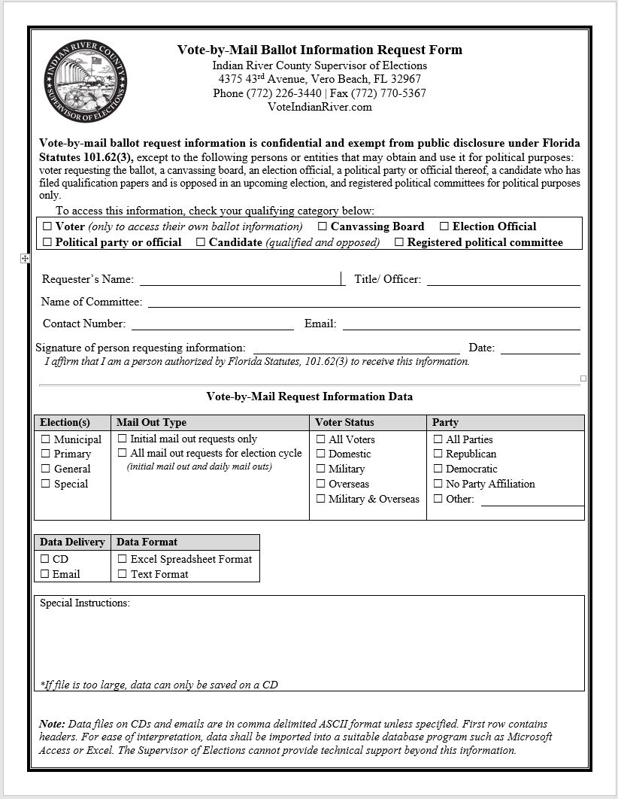
Look at your next handout

Slide 166
Requesting Registered Voter Information
Payment for any requested list must be paid by cash or check
We do not accept credit cards or debit cards for payment

Slide 167
Why would I need this list?
Walk a neighborhood house-by-house
Send flyers to registered voters
Send flyers to households
Review previous voting history

Slide 168
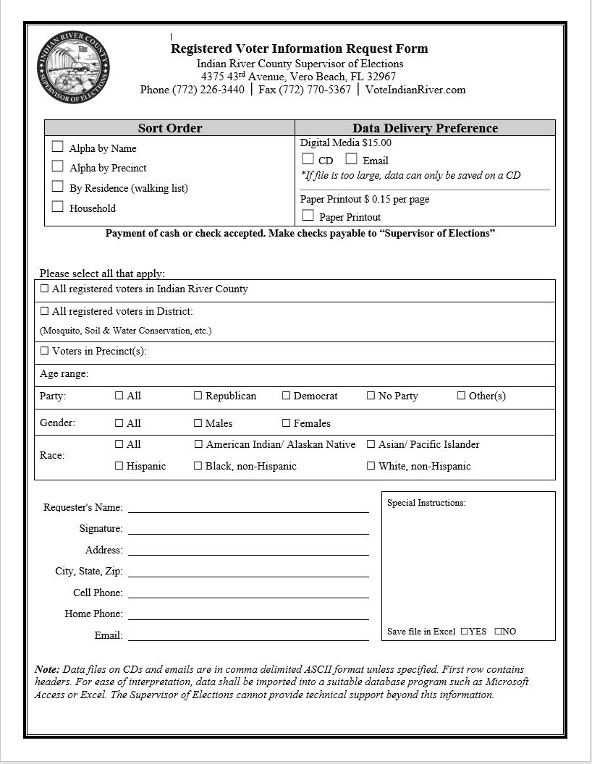
Look at your next handout

Slide 169
List Categories
Lists of registered voters from Indian River County are formatted in Excel and can be sorted by:
Name
Precinct
Residence
Household
Specific district
Specific age range
Gender
Race
Party

Slide 170
ETHICAL CONDUCT

Slide 171
Speaking at Public Meetings
Candidates may not pay money or give anything of value for speaking at a political meeting to further their candidacy
Candidates may not make any contribution in the name of another, directly or indirectly

Slide 172
Contribution Solicitation
Candidates may not solicit contributions from or make contributions in exchange for political support to any religious, charitable, political party, civic or other organizations established primarily for the public good

Slide 173
Use of Campaign Funds
A candidate may use campaign funds to purchase tickets, admission to events, or advertisements from the following groups:
Religious
Charitable
Political party
Civic

Slide 174
Memberships
Candidates may continue membership in and, if they have been a member for more than six month, make donations to the following groups:
Religious
Charitable
Political party
Civic

Slide 175
Malicious Statements
A candidate may not, with actual malice, make any false statement about an opposing candidate This is a felony of the third degree per Section 04.271 F.S.

Slide 176
Judicial Candidate Limitations
Judicial candidates shall not participate in any partisan political party activities except:
Register to vote as a member of any political party
Voting in any party primary contest

Slide 177
Judicial Candidate Limitations
Limitations on political activity:
Campaign as a member of any political party
Publicly represent or advertise herself/himself as a political party member
Make political speeches other than in the candidate’s own behalf

Slide 178
Judicial Candidate Limitations
A candidate for judicial office shall not:
Make contributions to a political party fund
Solicit or accept contributions for any political party

Slide 179
Judicial Candidate Limitations
A candidate for judicial office shall not:
Accept or retain a place on any political party committee
Make any contributions to (person, group, or organization) for its endorsement to judicial office
Agree to pay all or any part of an advertisement sponsored by any person, group or organization where the candidate may be endorsed for judicial office

Slide 181
Election Night Results
Election night voting results are released after the polls are closed:
Early voting totals and vote-by-mail ballot totals are released within 30 minutes
Election day results are updated every 45 minutes thereafter

Slide 182
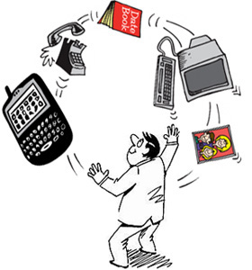
Candidate Responsibilities
As the candidate, you are responsible for all aspects of your campaign

Slide 183
Polling Place Etiquette
Candidates and campaign volunteers, please take time to look around the polling sites before you leave on election day and pick up any remaining signs, flyers, trash, etc.
Our office is very fortunate to have such nice facilities available for us to rent on election day

Slide 184
Thank You and
Good Luck!

