Slide 1
Third-Party Voter Registration Organization 3PVRO for short!
Helpful Hints

Slide 2
What is a Third-Party Voter Registration Organization?
A Third Party Voter Registration Organization is any:
person
entity
organization
that collects any voter registration application

Slide 3
Registered with State of Florida Division of Elections
All Third Party Voter Registration Organizations:
Must be registered with the State of Florida
Division of Elections
Must timely submit all voter registration applications collected to the Division of Elections (the division) or supervisor of elections in the county in which the applicant resides

Slide 4
Include 3PVRO number on all voter registration applications
Place assigned ID # on any voter registration applications delivered to the division or the supervisor of elections in the county in which the applicant resides
The assigned ID # will be 3P _ _-_ _
The assigned ID # must be recorded on the bottom portion of the back side of the voter registration application
3P _ _- _ _

Slide 5
3PVRO Notification to Applicants
A 3PVRO must notify the applicant at the time the application is collected that the organization might not deliver the application to the division or the supervisor of elections in the county in which the applicant resides in less than 14 days or before registration closes for the next ensuing election and must advise the applicant that he or she may deliver the application in person or by mail.
The 3PVRO must also inform the applicant how to register online with the division and how to determine whether the application has been delivered.

Slide 6
Deliver Voter Registration Applications
Must promptly deliver all complete, incomplete and voided voter registration applications to:
Division of Elections
OR
Supervisor of elections in the county in which the applicant resides
Within 14 days of collection*
*Keep book closing dates in mind, as applications must be delivered on or before book closing, even if the book closing date is fewer than 14 days!

Slide 7
Not promptly delivered?
Please be aware:
If voter registration applications are not delivered promptly to the division or the supervisor of elections in the county in which the applicant resides, the 3PVRO will be fined:
$50 for each application not received by the 14-day deadline/$250 for each application if the 3PVRO acted willfully
$100 for each application collected before book closing deadline but received after the book closing deadline/$500 for each application if the 3PVRO acted willfully
$500 for each application never submitted/$1,000 for each application if the 3PVRO acted willfully

Slide 8
Date applicant signs the registration application…
The date an applicant signs the voter registration application is the date the 3PVRO receives or collects the application
3PVRO organization must record this date on the back side of the application
Voter registration applications turned in by the 3PVRO will be time / date stamped when they are received by the SOE office

Slide 9
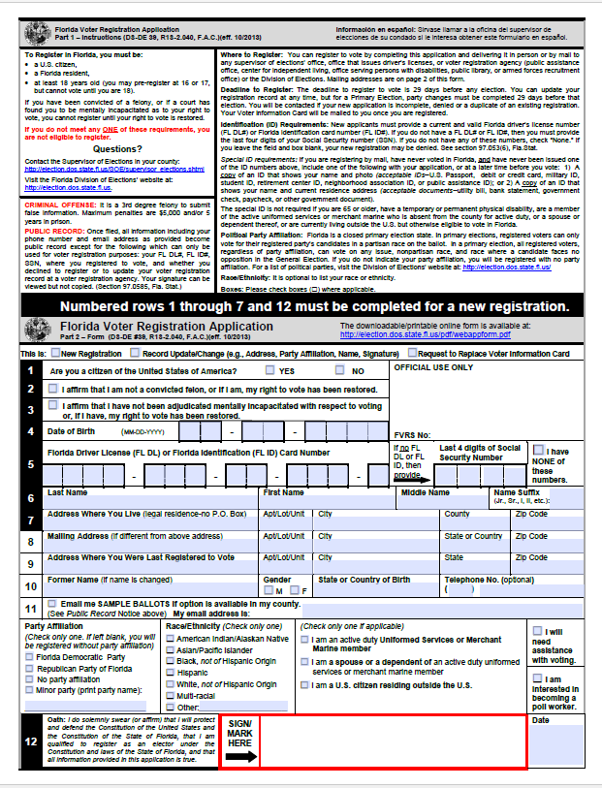
Can 3PVRO’s assist an applicant in filling out form?
YES:
Assist applicant in filling out the
application as long as the
applicant signs and dates the
form
Review the application and tell applicant if the required numbered rows are not filled out making an
application incomplete

Slide 10
Remember!
3PVRO’s are responsible for ALL voter registration forms provided to them
Always turn in ALL voter registration applications filled out
by applicant, whether they are complete, incomplete, or voided
If a voter makes an error on the application:
Write VOID on the form and give them a new one
Return the VOIDED form to the Elections Office

Slide 11
Information missing on application?
If an applicant has filled out a voter registration application and you
later discover that the application is incomplete:
Turn the incomplete application into our office.
Our office will enter the incomplete application into the
registration database
Applicant will be mailed a letter explaining what
information is missing along with a voter registration form
Applicant will fill in the missing information on the form
and return the completed application to the Elections Office

Slide 12
All applications submitted will be accounted for
When applications are turned in, SOE office will fill out:
Accounting of Third-Party Voter Registration Organization Applications ( DS-DE 124) form and provide a copy to 3PVRO
Form states the number of voter registration applications provided to your organization from our office
Form states the number of voter registration applications received from your organization, including blank and
non-blank forms

Slide 13
Remember…
If 3PVRO provides a blank application to an applicant and they intend to take it with them to fill out elsewhere:
It MUST be a blank application without a 3PVRO ID number on it
If 3PVRO provides a blank application to an applicant and they hand back a completed application:
It MUST be an application with a 3PVRO ID number on it

Slide 14
QUESTIONS ?

